Slide 1

Health Physics Association at UOIT

Slide 2
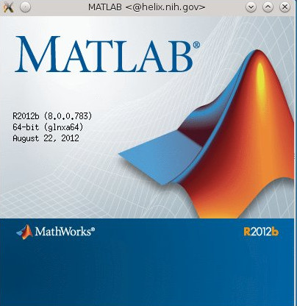
Introduction to
physics simulations
MATLAB
Matrices
Physics Simulation
Monte Carlo

Slide 3
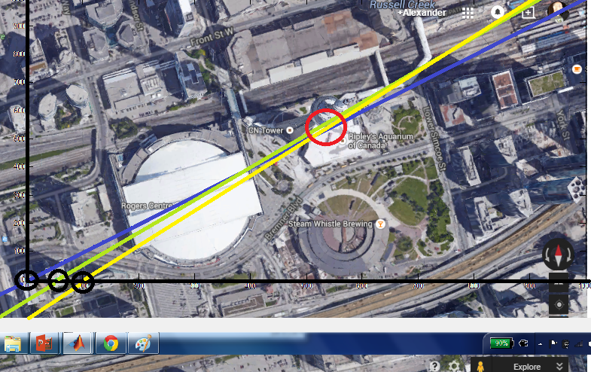
Matrices : System of Linear Equations

Slide 4
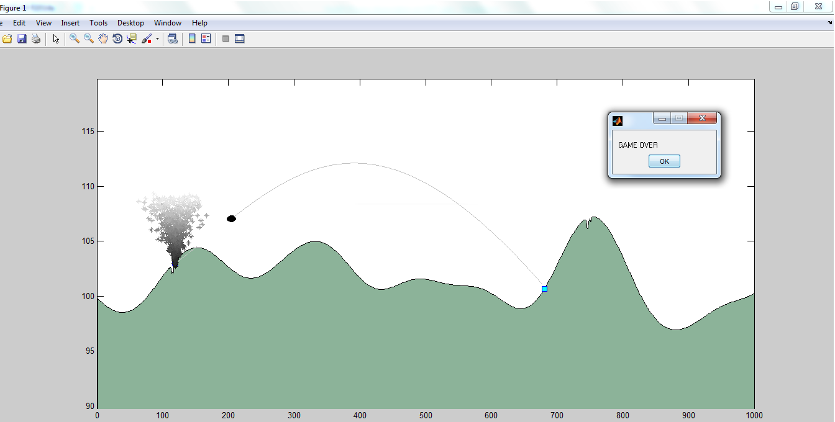
Physics : TANK BATTLE!!!!!!

Slide 5
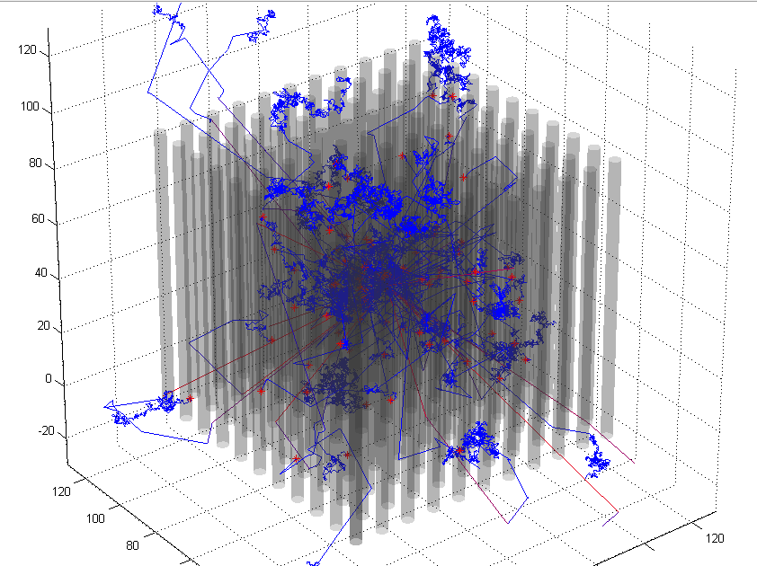
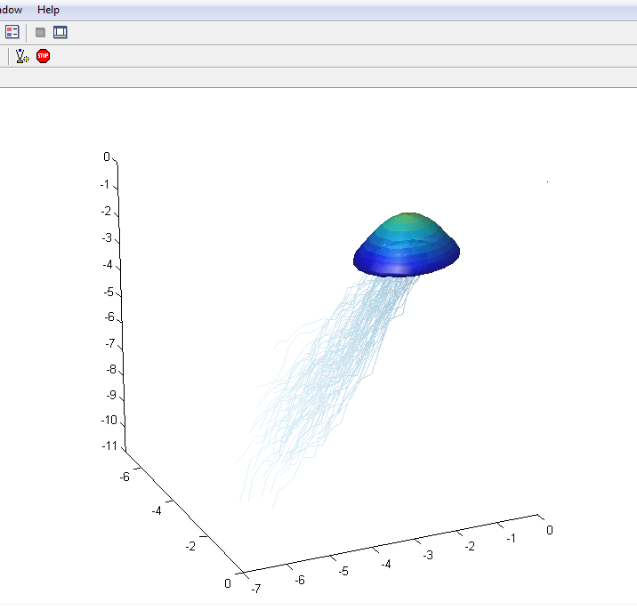
Monte Carlo : Particle Simulations

Slide 6
Matrices – Systems of equations

Slide 7
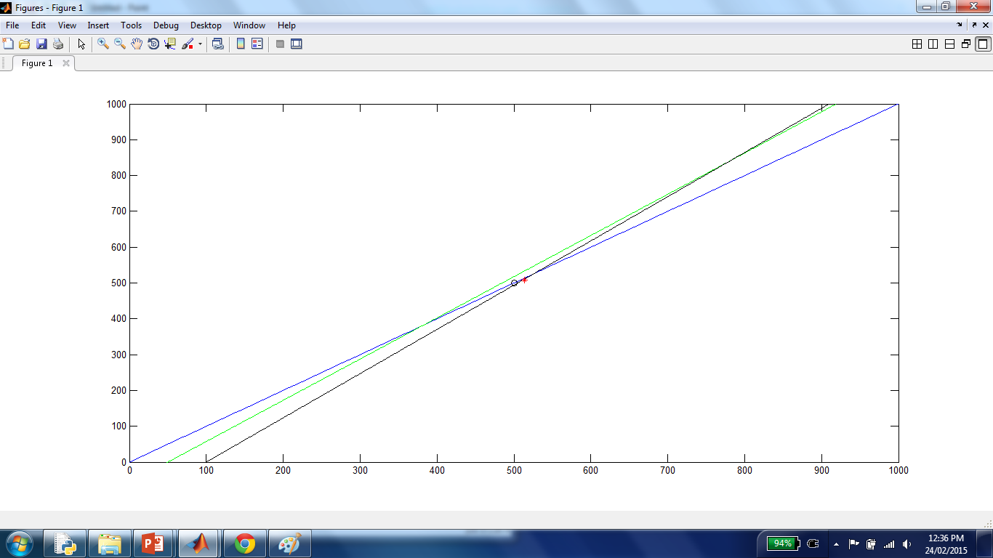
Over constrained Intersection of Lines

Slide 8
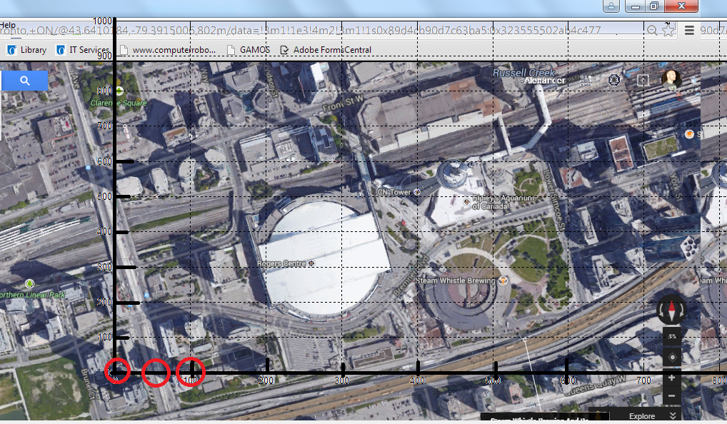
Where is the CN tower and how far away is it ?

Slide 9
Estimated Directions
At our original position (0,0) it is about 45 deg
After we walk 50m due east (50, 0) it is about 49 deg
After we walk 100m due east (100,0) it is about 51 deg

Slide 10
Matrices : System of Linear Equations

Slide 11
TANK BATTLE!!!!!!

Slide 12
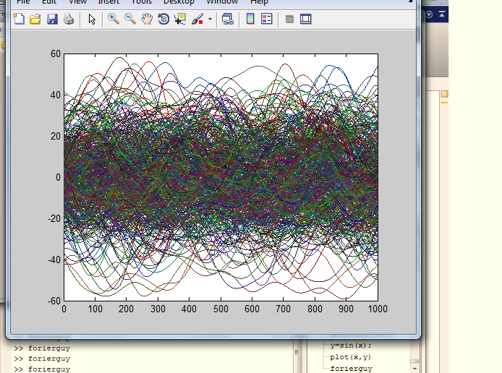
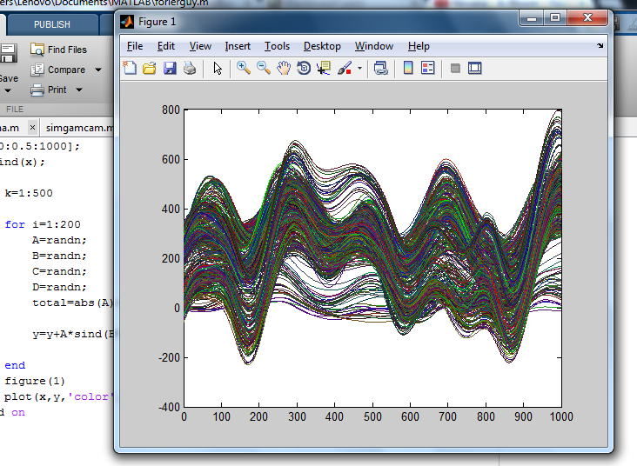
Monte Carlo

Slide 13
Monte Carlo

Slide 14
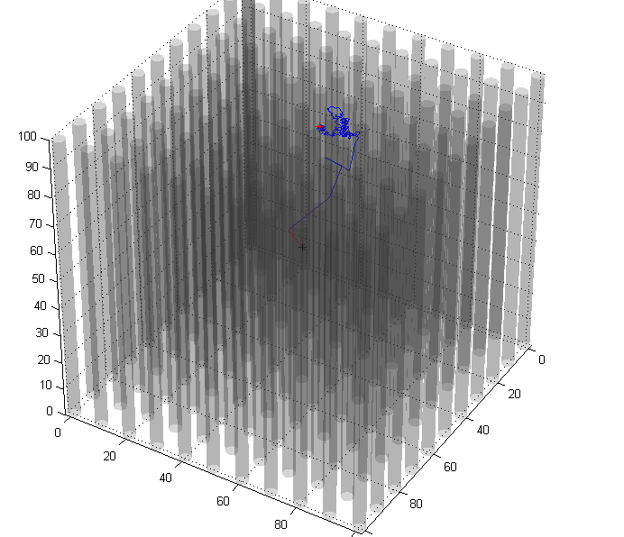
Monte Carlo

Slide 15
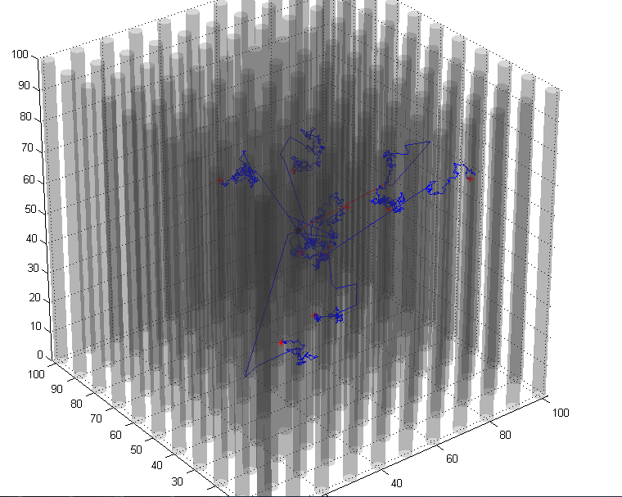
Monte Carlo

Slide 17
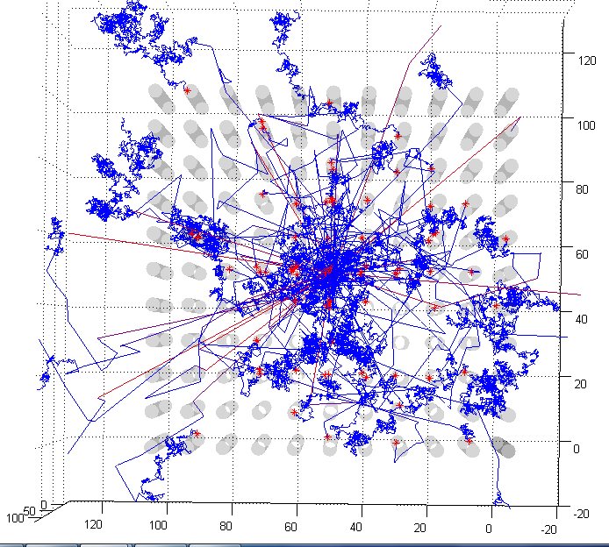

Slide 18
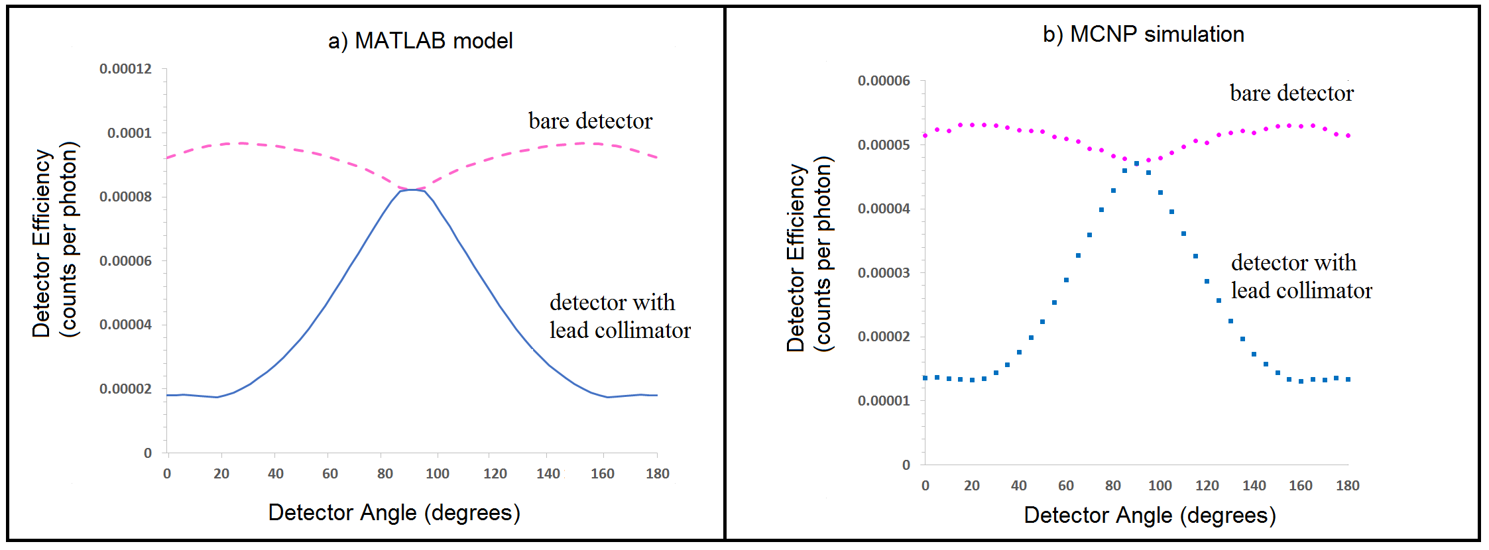
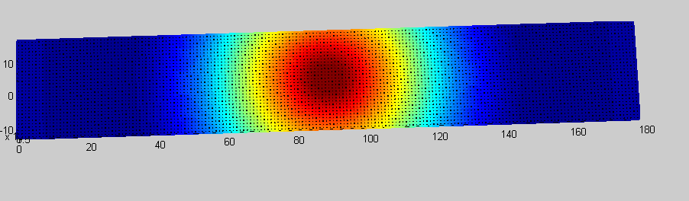
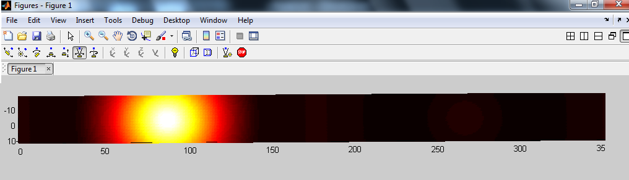
Further

